Slide 1
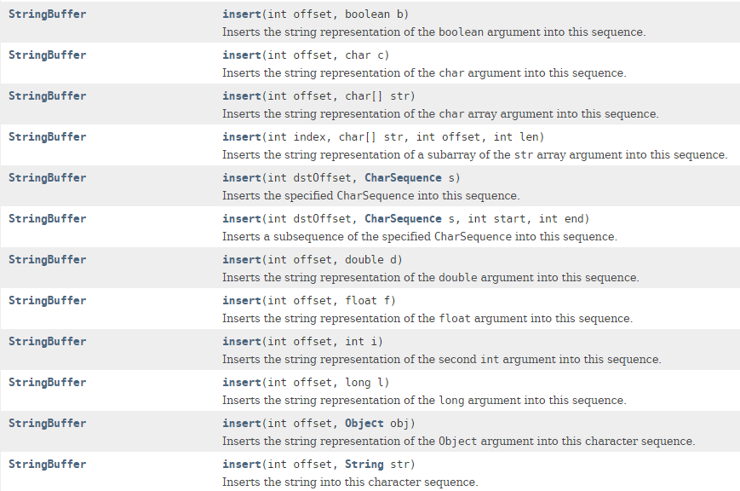
StringBuffer – insert method

